Slide 1

CERA TILES

Slide 2
GROUP MEMBERS
NGUYỄN THỊ DIỄM HƯƠNG
TRƯƠNG MINH QUÂN
Instructor :
PHAN HỮU TRÍ
1.
2.

Slide 3
TECHNOLOGY AND TOOLS
-Laravel
-HTML, CSS, Bootstrap, JQuery
-MySQL
-XAMPP

Slide 4
INTRODUCE
ADMIN
CLIENT
Purpose : Comprehensive management and optimization of website operations.
Function : Manage products, orders, customers, promotions, employee…
Purpose : Provide a convenient and safe online shopping experience for customers.
Function : Search for products, add to cart, pay, track orders, and get customer support.

Slide 5
ADMIN
01
DASHBOARD
02
COMPANY
The dashboard summarizes site activity, including overall statistics, charts.
Manage company information, including name, address, and contact information.
03
EMPLOYEE
04
CATEGORY
Manage employee information, including profiles, roles, and access permissions.
Manage product categories, help classify and organize products effectively.
05
PRODUCT
06
ORDER
Manage product information, including adding, editing, and deleting products from the system.
Order management, see order value and order details

Slide 6
ADMIN - CUSTOMER CARE
01
FEE AND VOUCHER
02
E-CATALOGUE
Manage shipping and promotional vouchers
Optimize product presentation, helping customers easily find and understand product information.
03
BLOG
Create and manage blog content, including articles, news, and product or business updates.

Slide 7
CLIENT
CART
REVIEWS AND COMMENTS
FILTER PRICE
Store products that customers choose to buy while surfing the web, allowing review and editing before ordering.
Allows customers to filter products based on price range, helping them find products that fit their budget.
Allow customers to leave reviews and comments on products after purchased.
COMPARE PRODUCTS
PAYMENT
Provides secure and diverse payment methods, including credit cards, bank transfers, or online payment services.
Provides detailed comparisons between different selected products by features, price, etc.

Slide 8
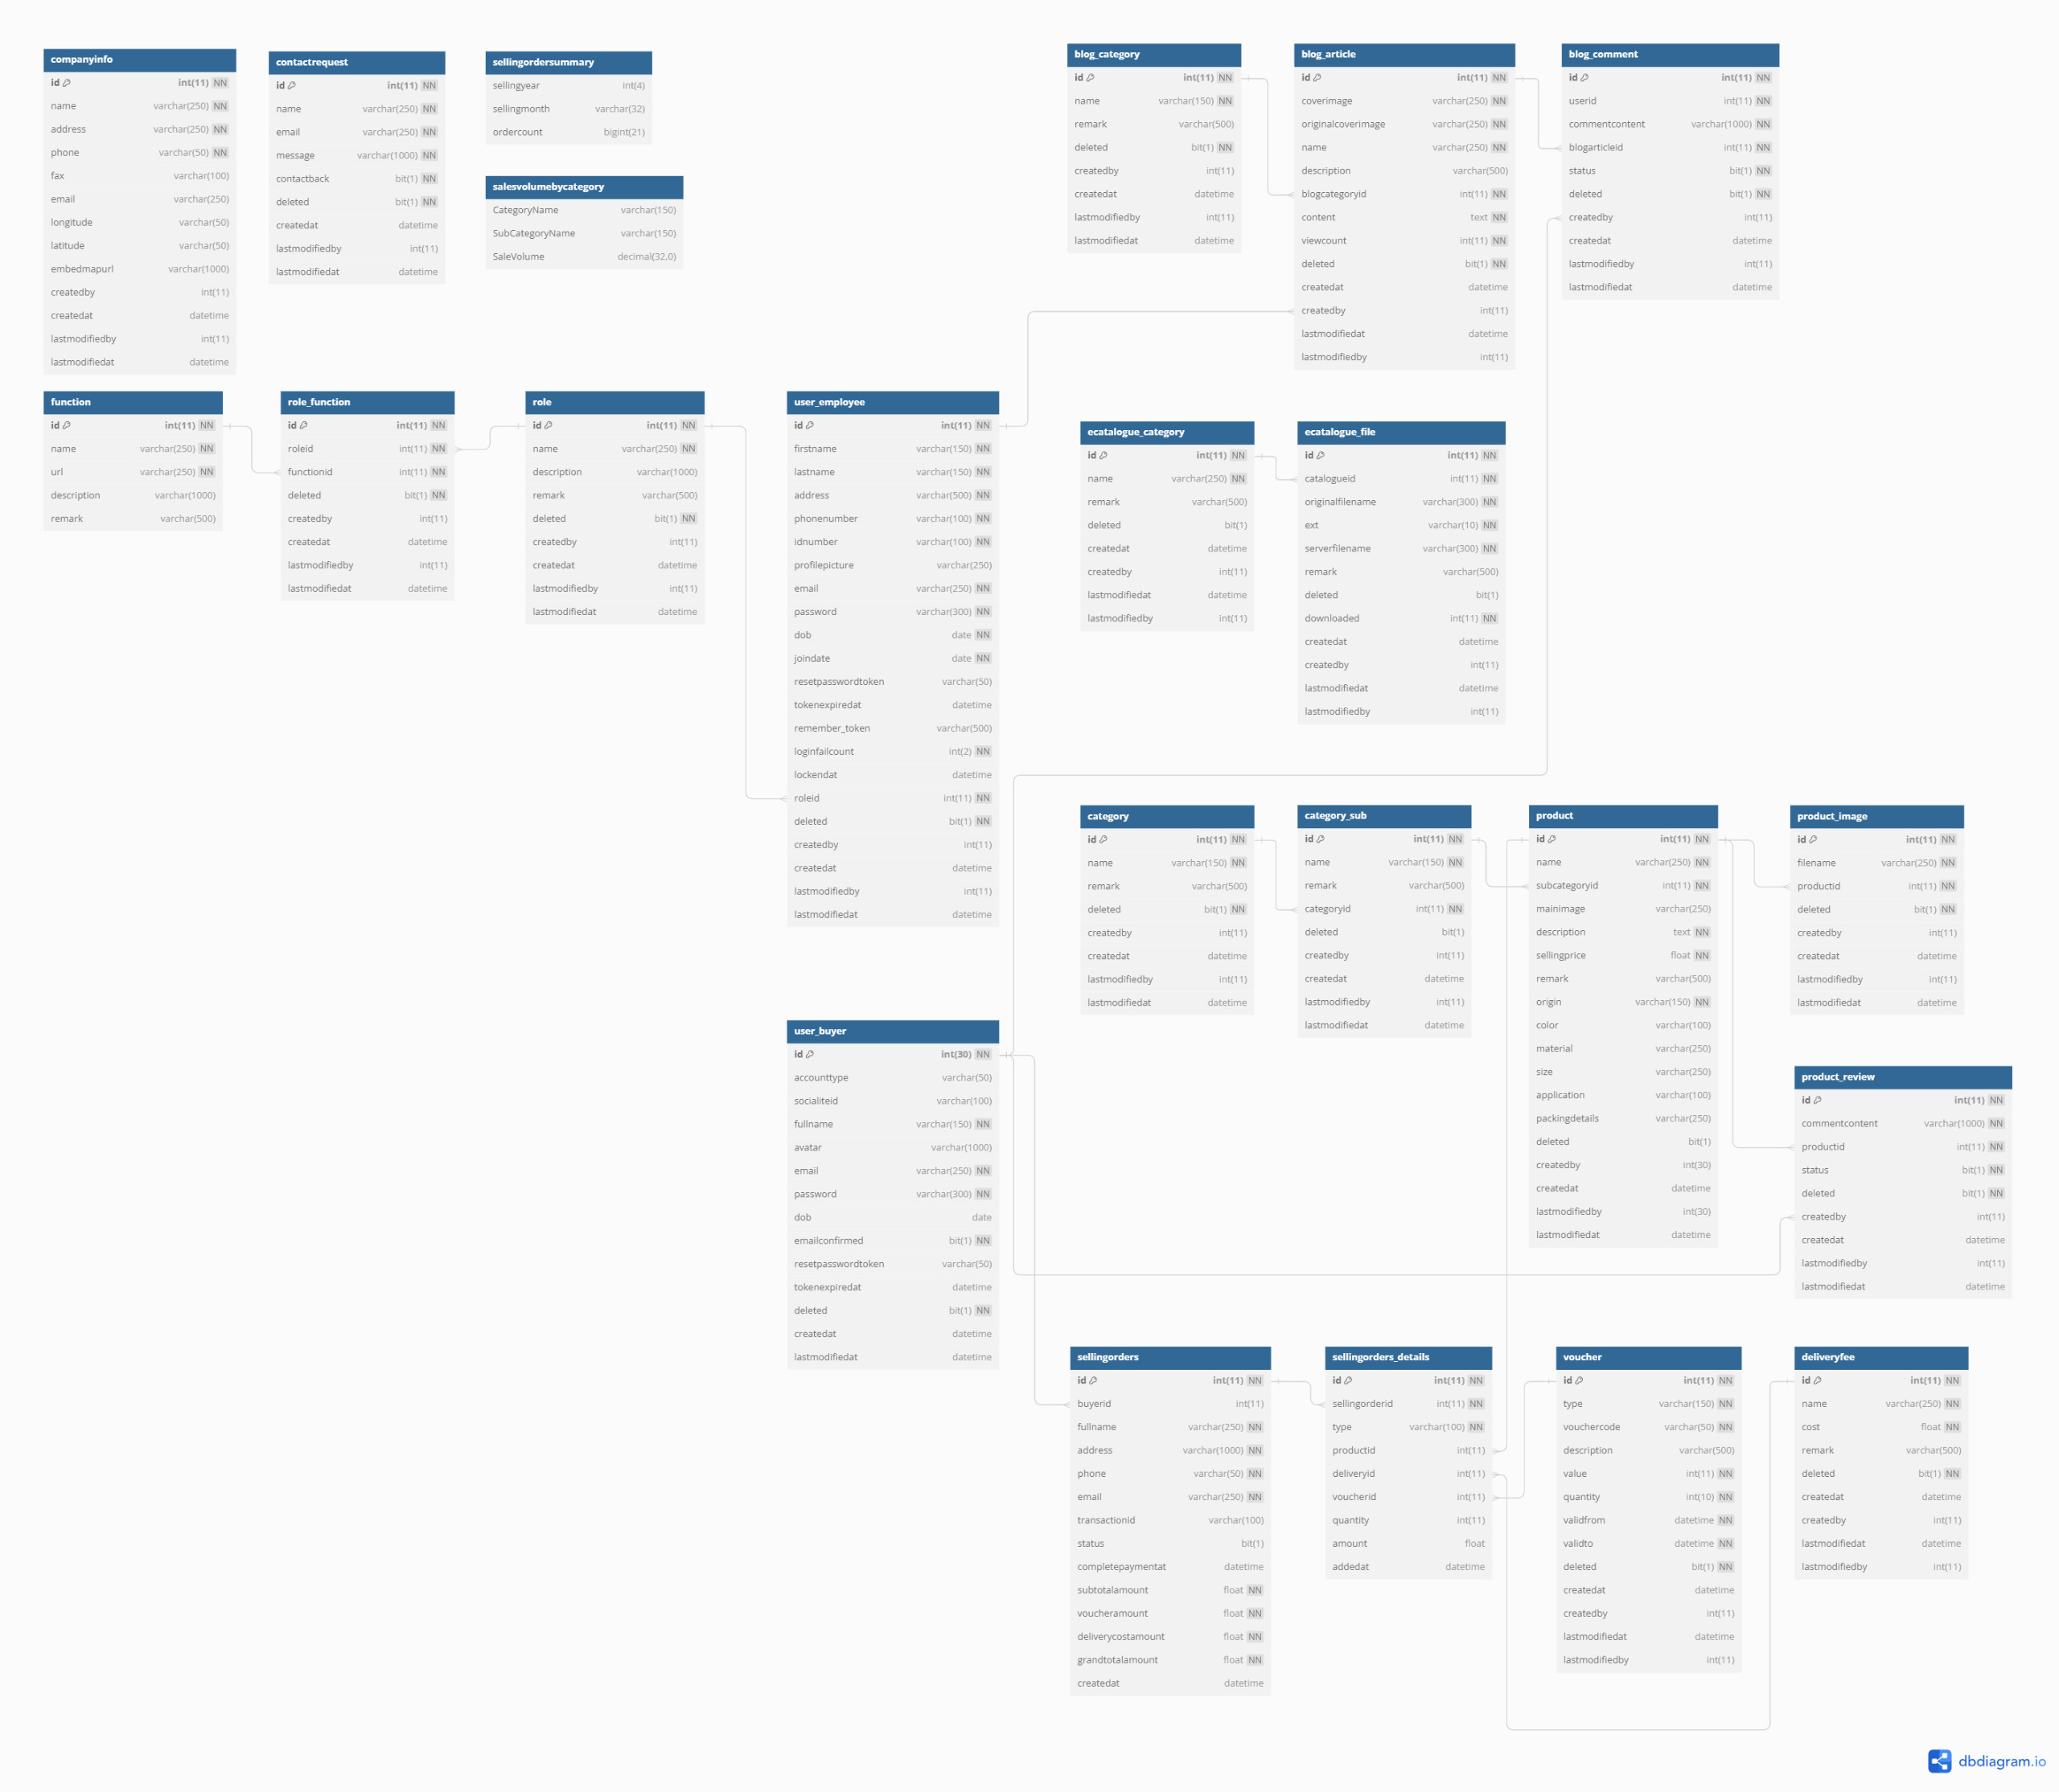
DATABASE

Slide 9
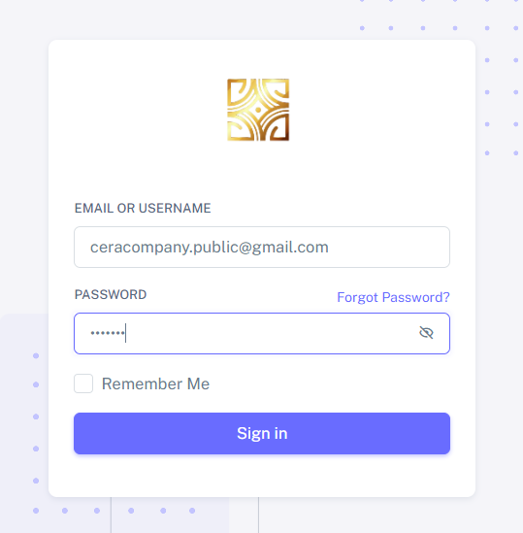
Before accessing the admin page, it is necessary to log in.

Slide 10
DASHBOARD

Slide 11
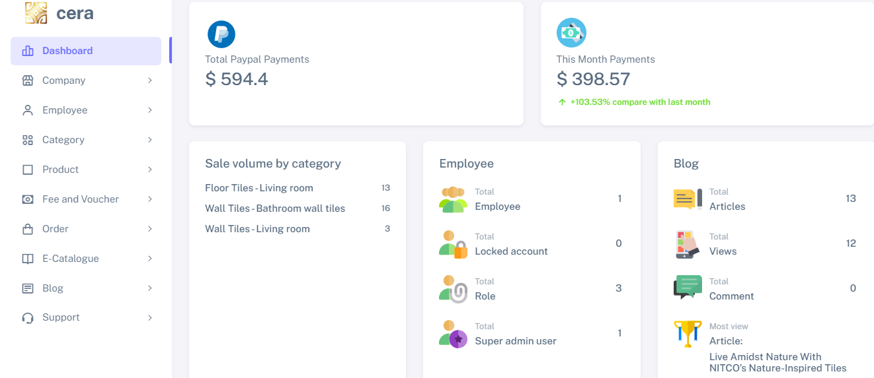
The dashboard function includes overall data such as total payment, total orders, sales volumes per category, and a summary of blog activity

Slide 12
COMPANY INFORMATION

Slide 13
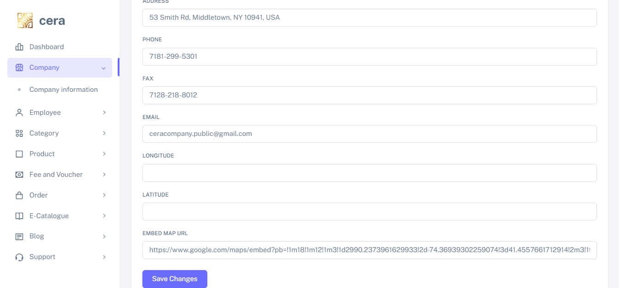
The company information feature allows users to input and manage company details for display on the contact page

Slide 14
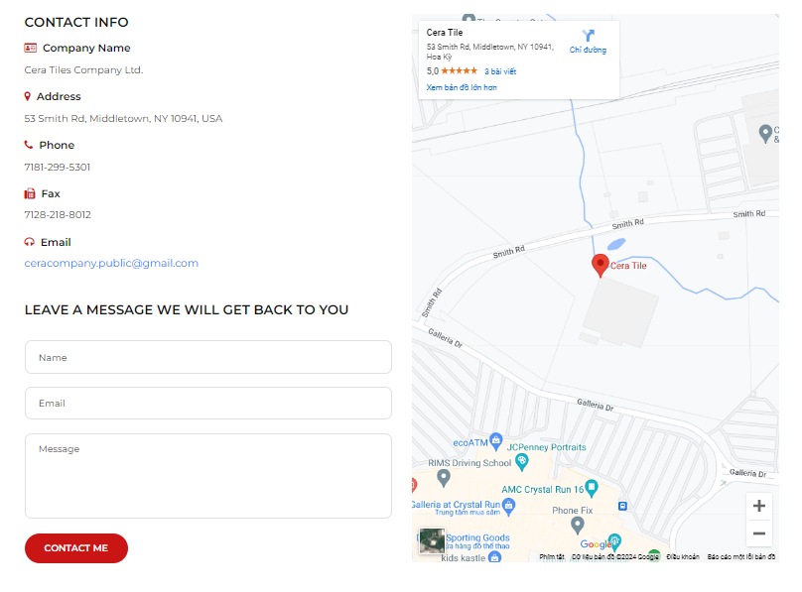

Slide 15
ROLE AND EMPLOYEE

Slide 16
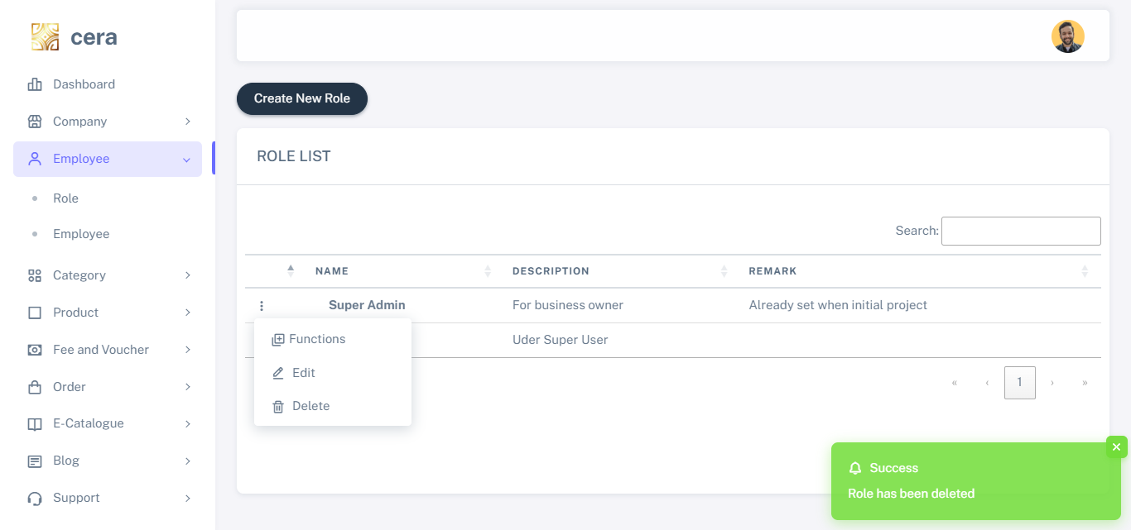
The role function allows users to create roles and assign to specific functions or permissions within the system

Slide 17
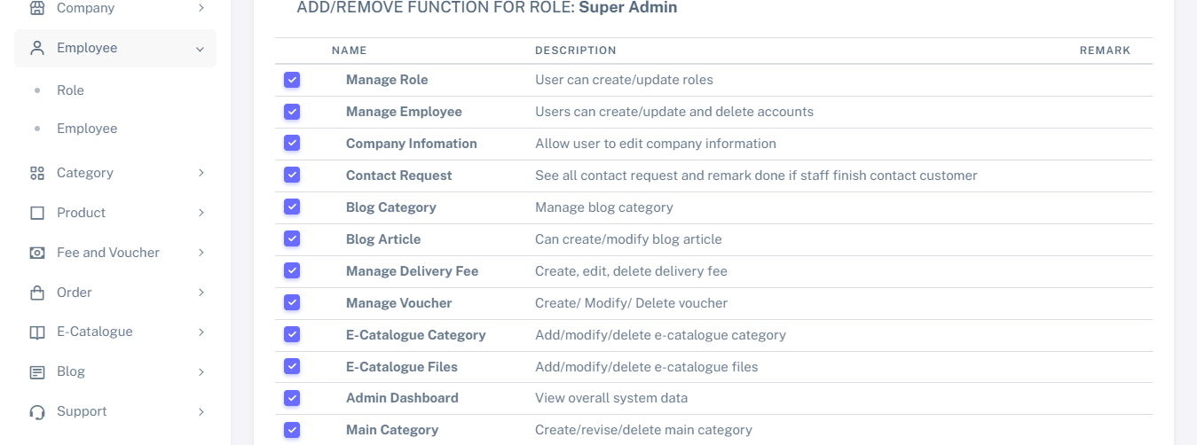
After clicking on “Functions”, you will be redirected to a screen where you can assign functions to a role

Slide 18
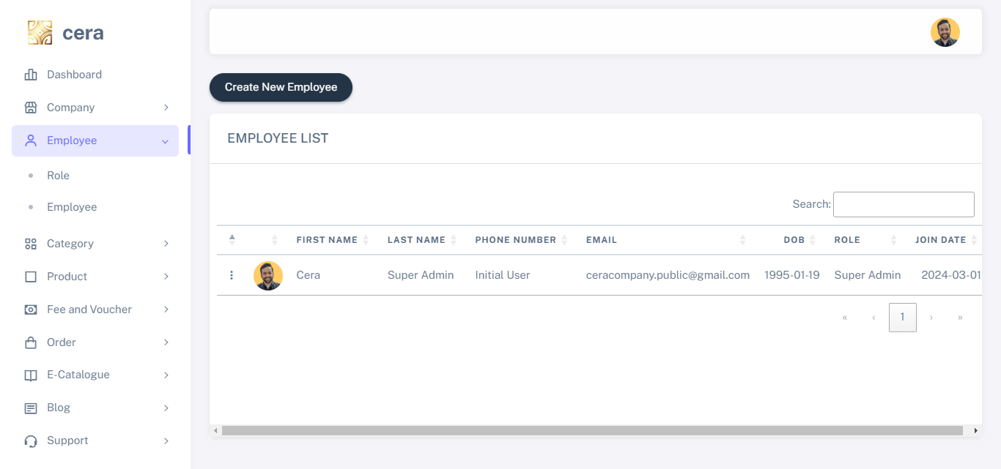
The employee function allows users to create, update, and delete employee records

Slide 19
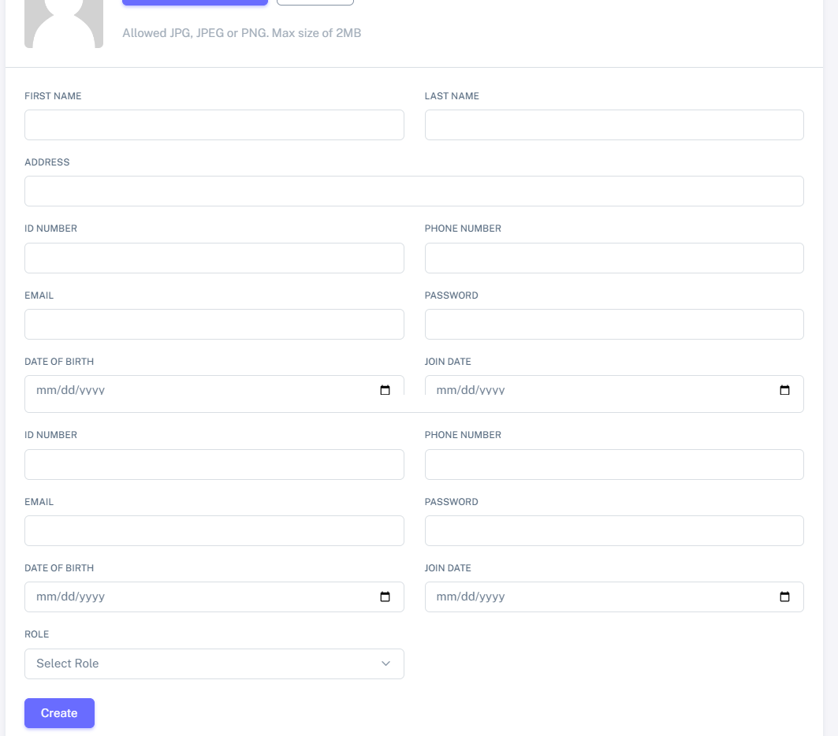
The roles that you have created will appear here

Slide 20
PRODUCT CATEGORY

Slide 21
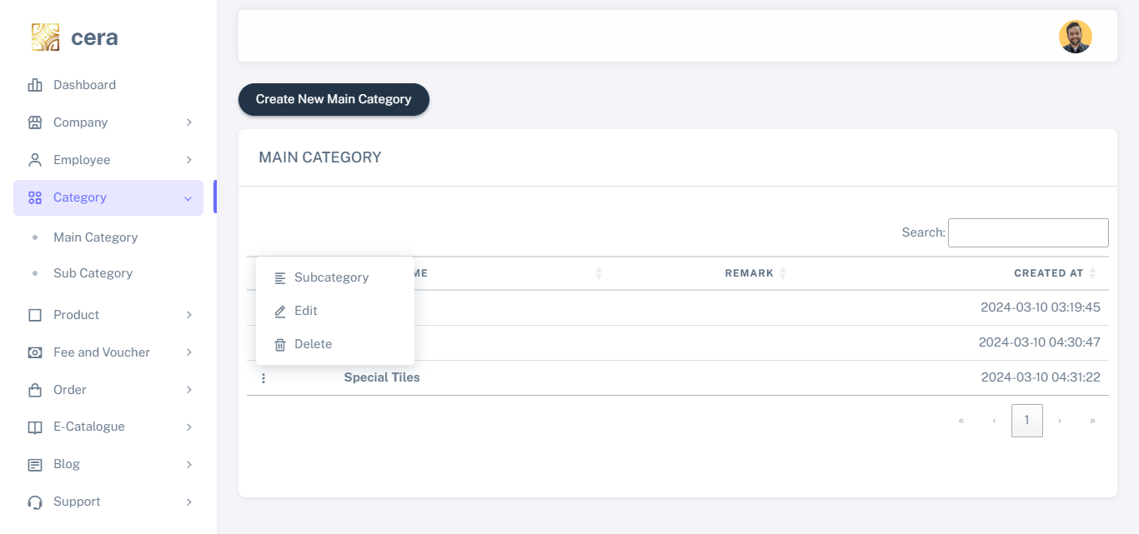
Main category

Slide 22
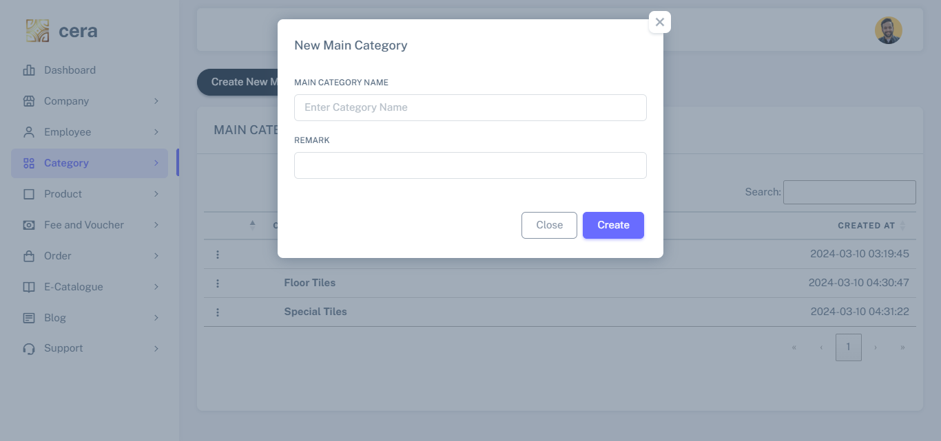
When you click on “Create New Main Category” a pop-up modal will appear

Slide 23
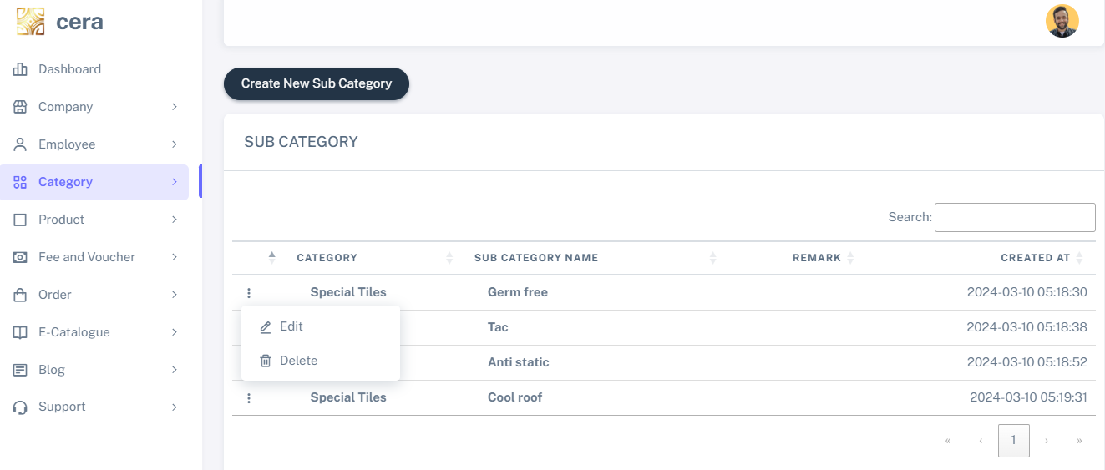
Subpages of the main product category.

Slide 24
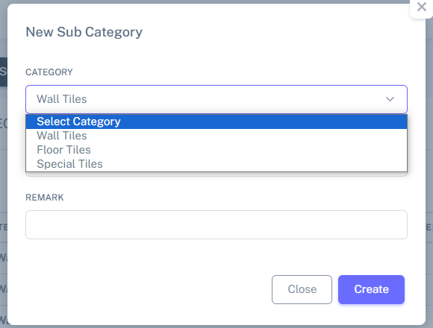
When you click on “Create New Sub Category” a pop-up modal will appear, listing all the categories you have created

Slide 25
PRODUCT

Slide 26
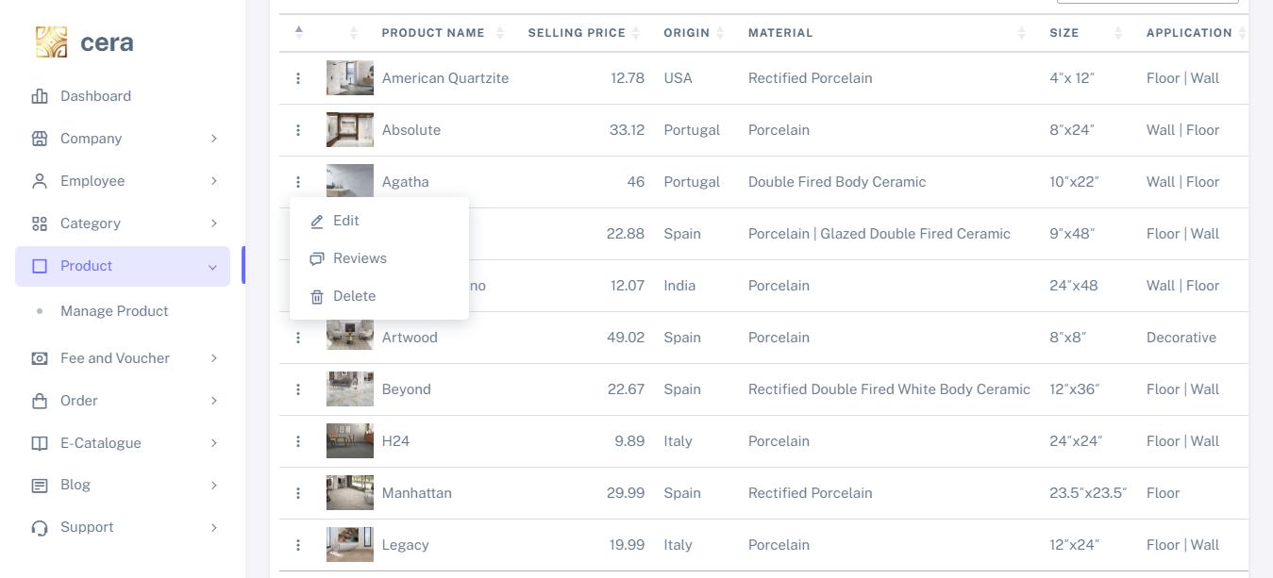
Click here to visit the product review page. (Note: Only customers who have purchased the product can leave a review
The manage product page allows you to create, update, and delete products, as well as manage previews for each product

Slide 27
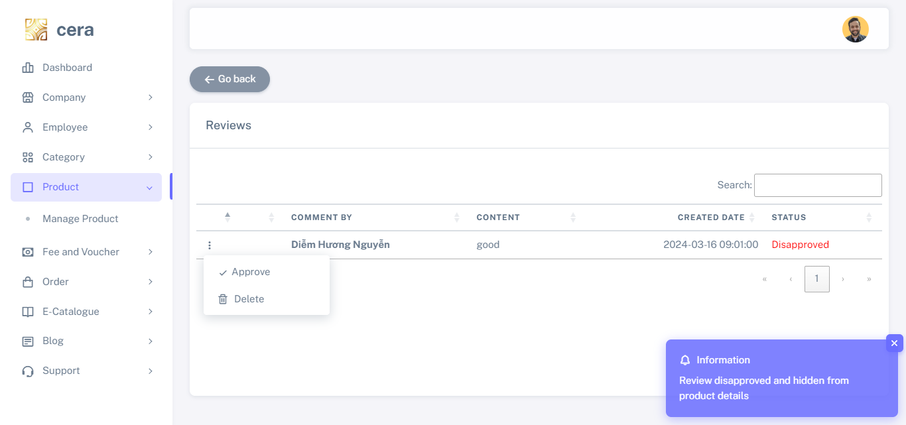
On this page, you can view customer reviews and choose whether to display them on the product page or not

Slide 28
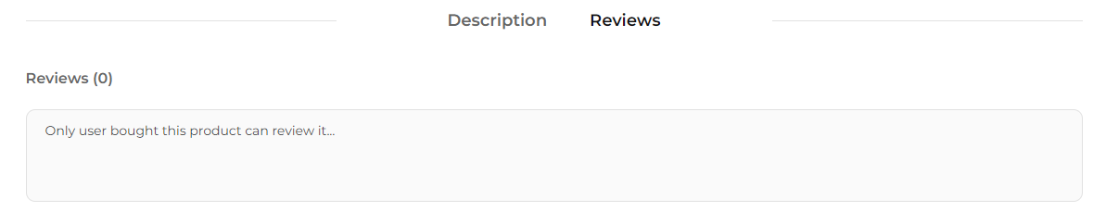
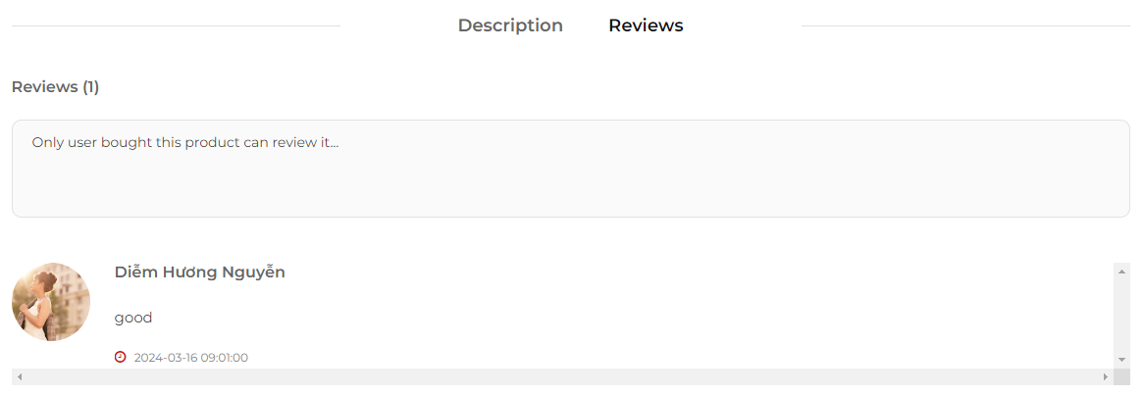
when admin not yet approved
when admin approved

Slide 29
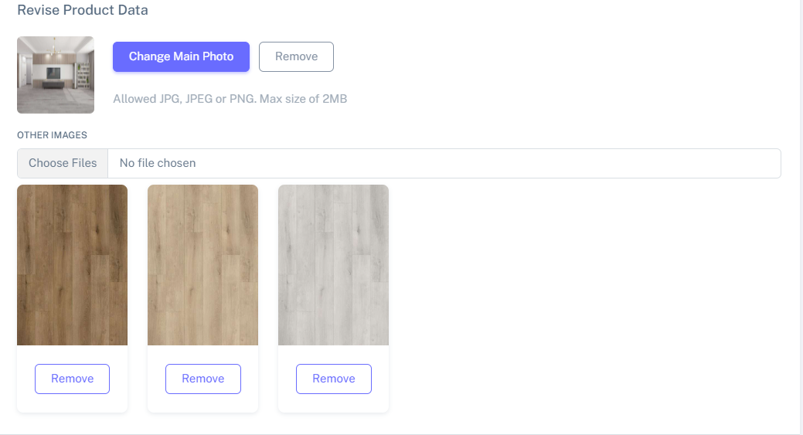
Photo change section in Product Edit Page

Slide 30
FEE AND VOUCHER

Slide 31
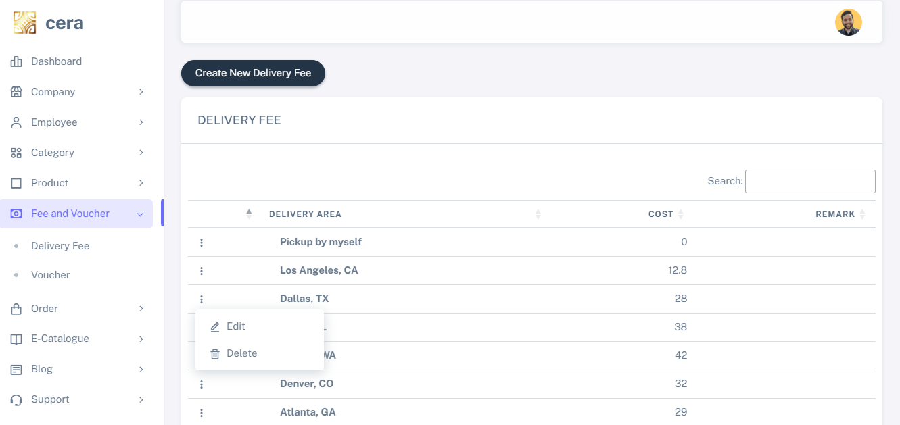
The delivery fee feature allows you to add areas and specify the amount of delivery fee for each area

Slide 32
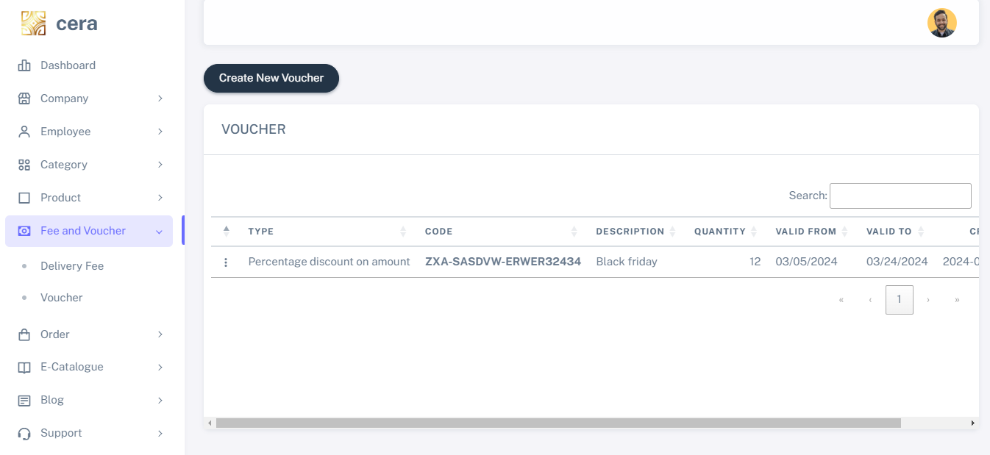
Where coupons will be added
The voucher function allows you to create discount vouchers. There are three types of vouchers available: Percentage off total amount, Percentage off delivery fee, and Specific amount discount

Slide 33
ORDER

Slide 34
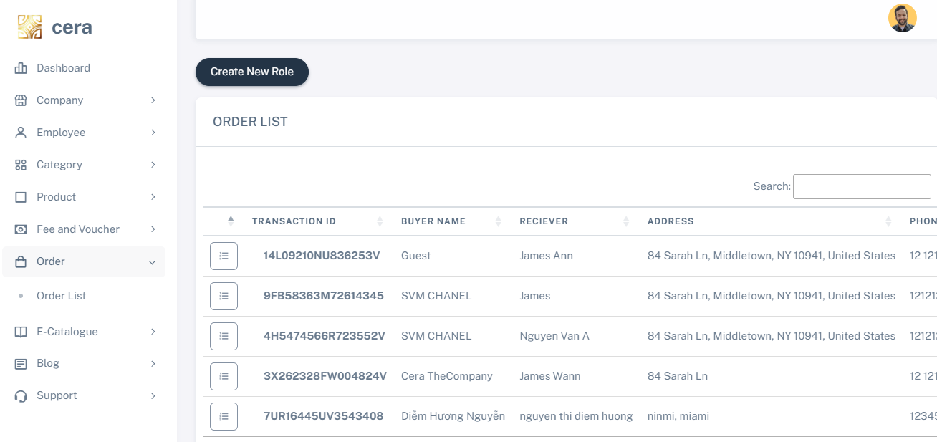
Click here to view details of the order the customer purchased
When a customer doesn't log in, the default name will be set to “Guest”

Slide 35
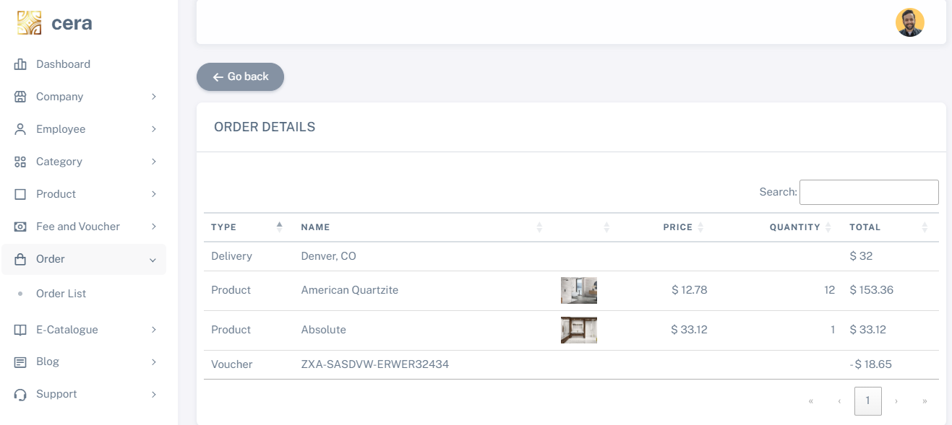
On the details page, you can view the products the customer purchased, the delivery fee, and the voucher code they used

Slide 36
E-CATALOGUE

Slide 37
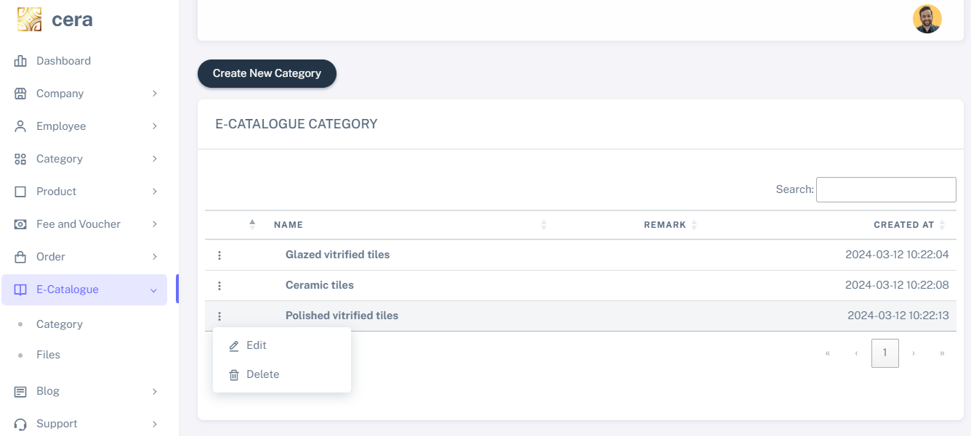
E-Catalogue type where you can create/update/delete catalogue type

Slide 38
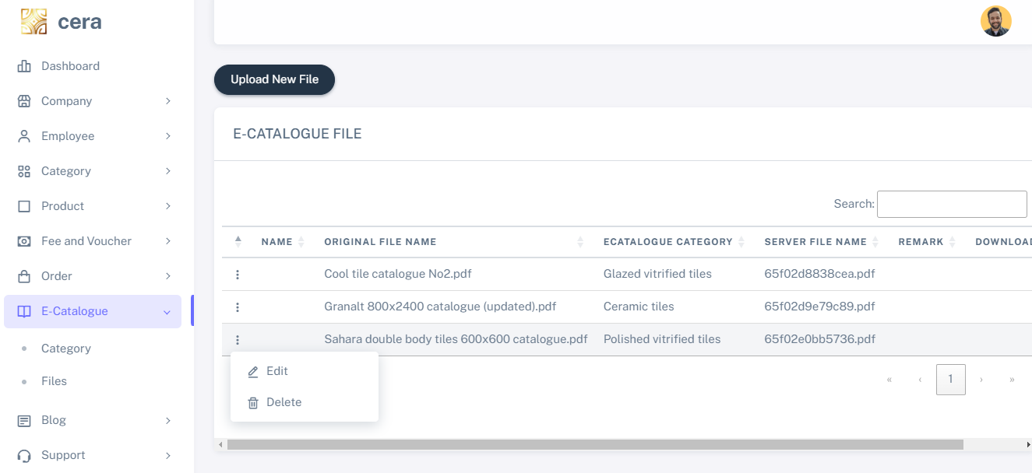
Files uploaded
A catalogue file allows you to upload, edit, and delete catalogue files

Slide 39
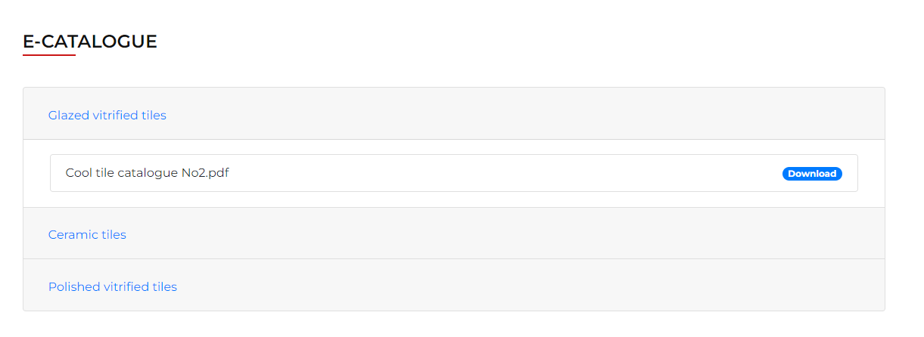
The catalogue type and files will be listed in the E-catalogue function on the customer site

Slide 40
BLOG

Slide 41
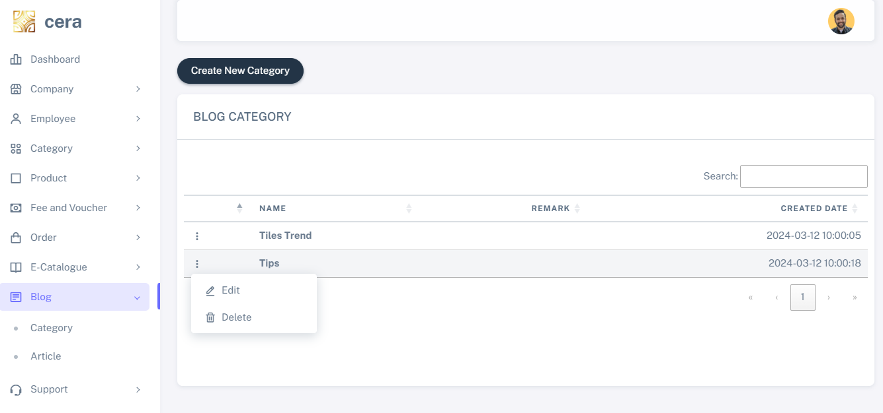
Create/update/delete blog category

Slide 42
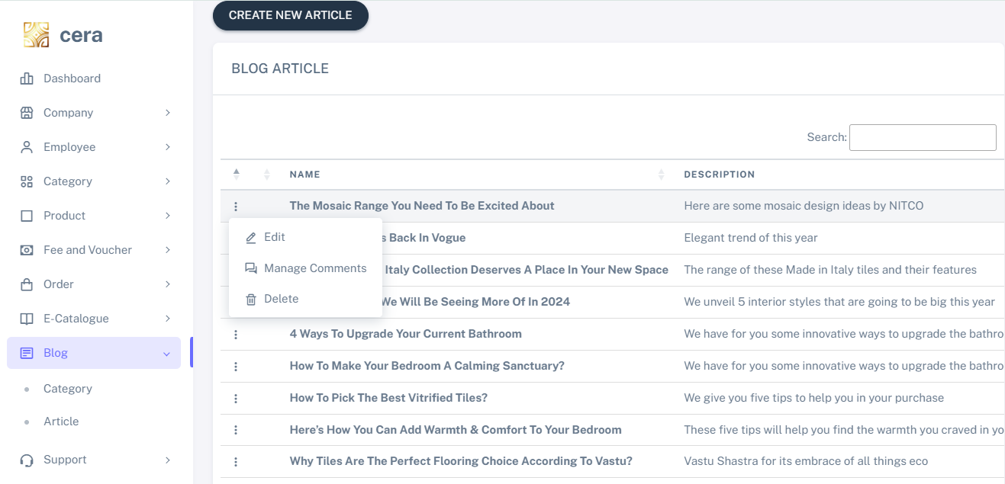
The article function allows users to compose blog posts

Slide 43
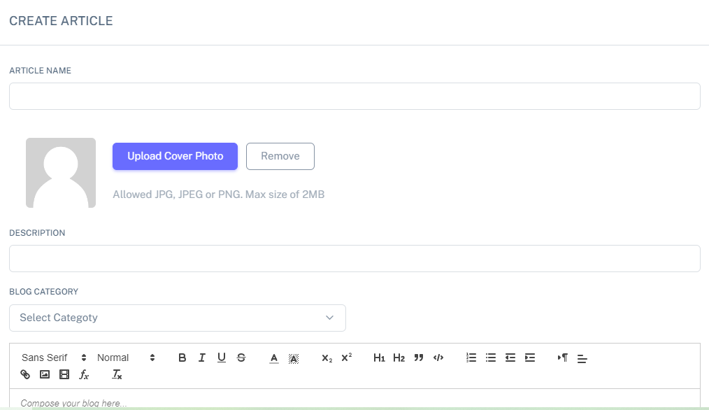
Adding articles to your blog can add images, attachments, videos,...

Slide 44
The manage comments feature enables you to approve or disapprove user comments

Slide 45
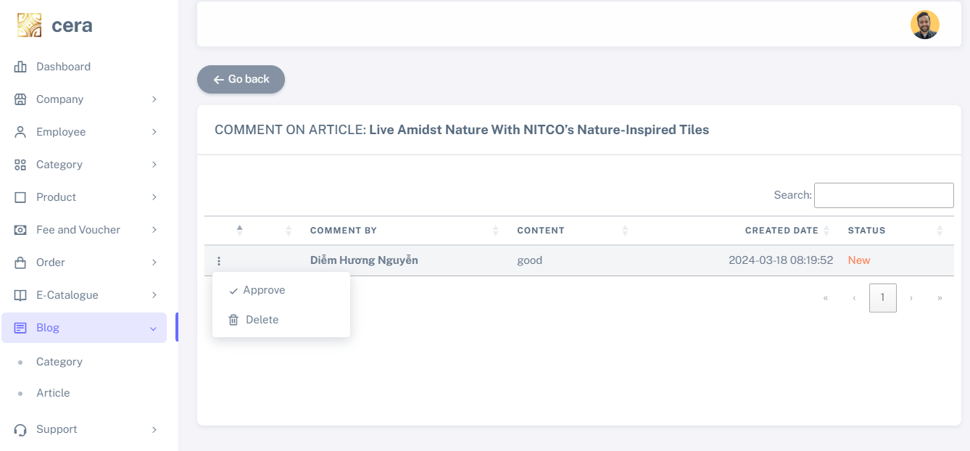
Select approve/disapprove to show/hide comment

Slide 46
CONTACT ME

Slide 47
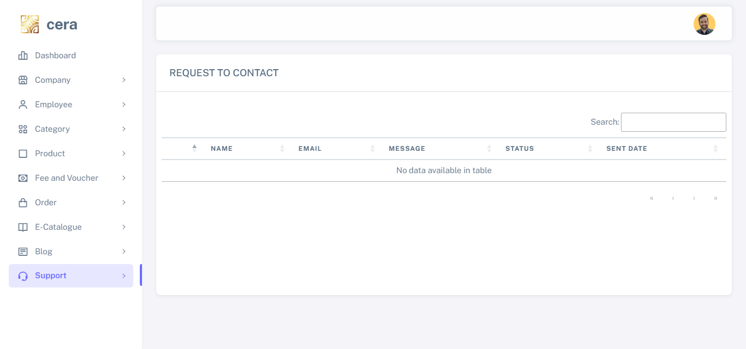
The support function allows you to view customer requests for contact and mark which ones have already been addressed by an employee

Slide 48
PUBLIC PAGES

Slide 49
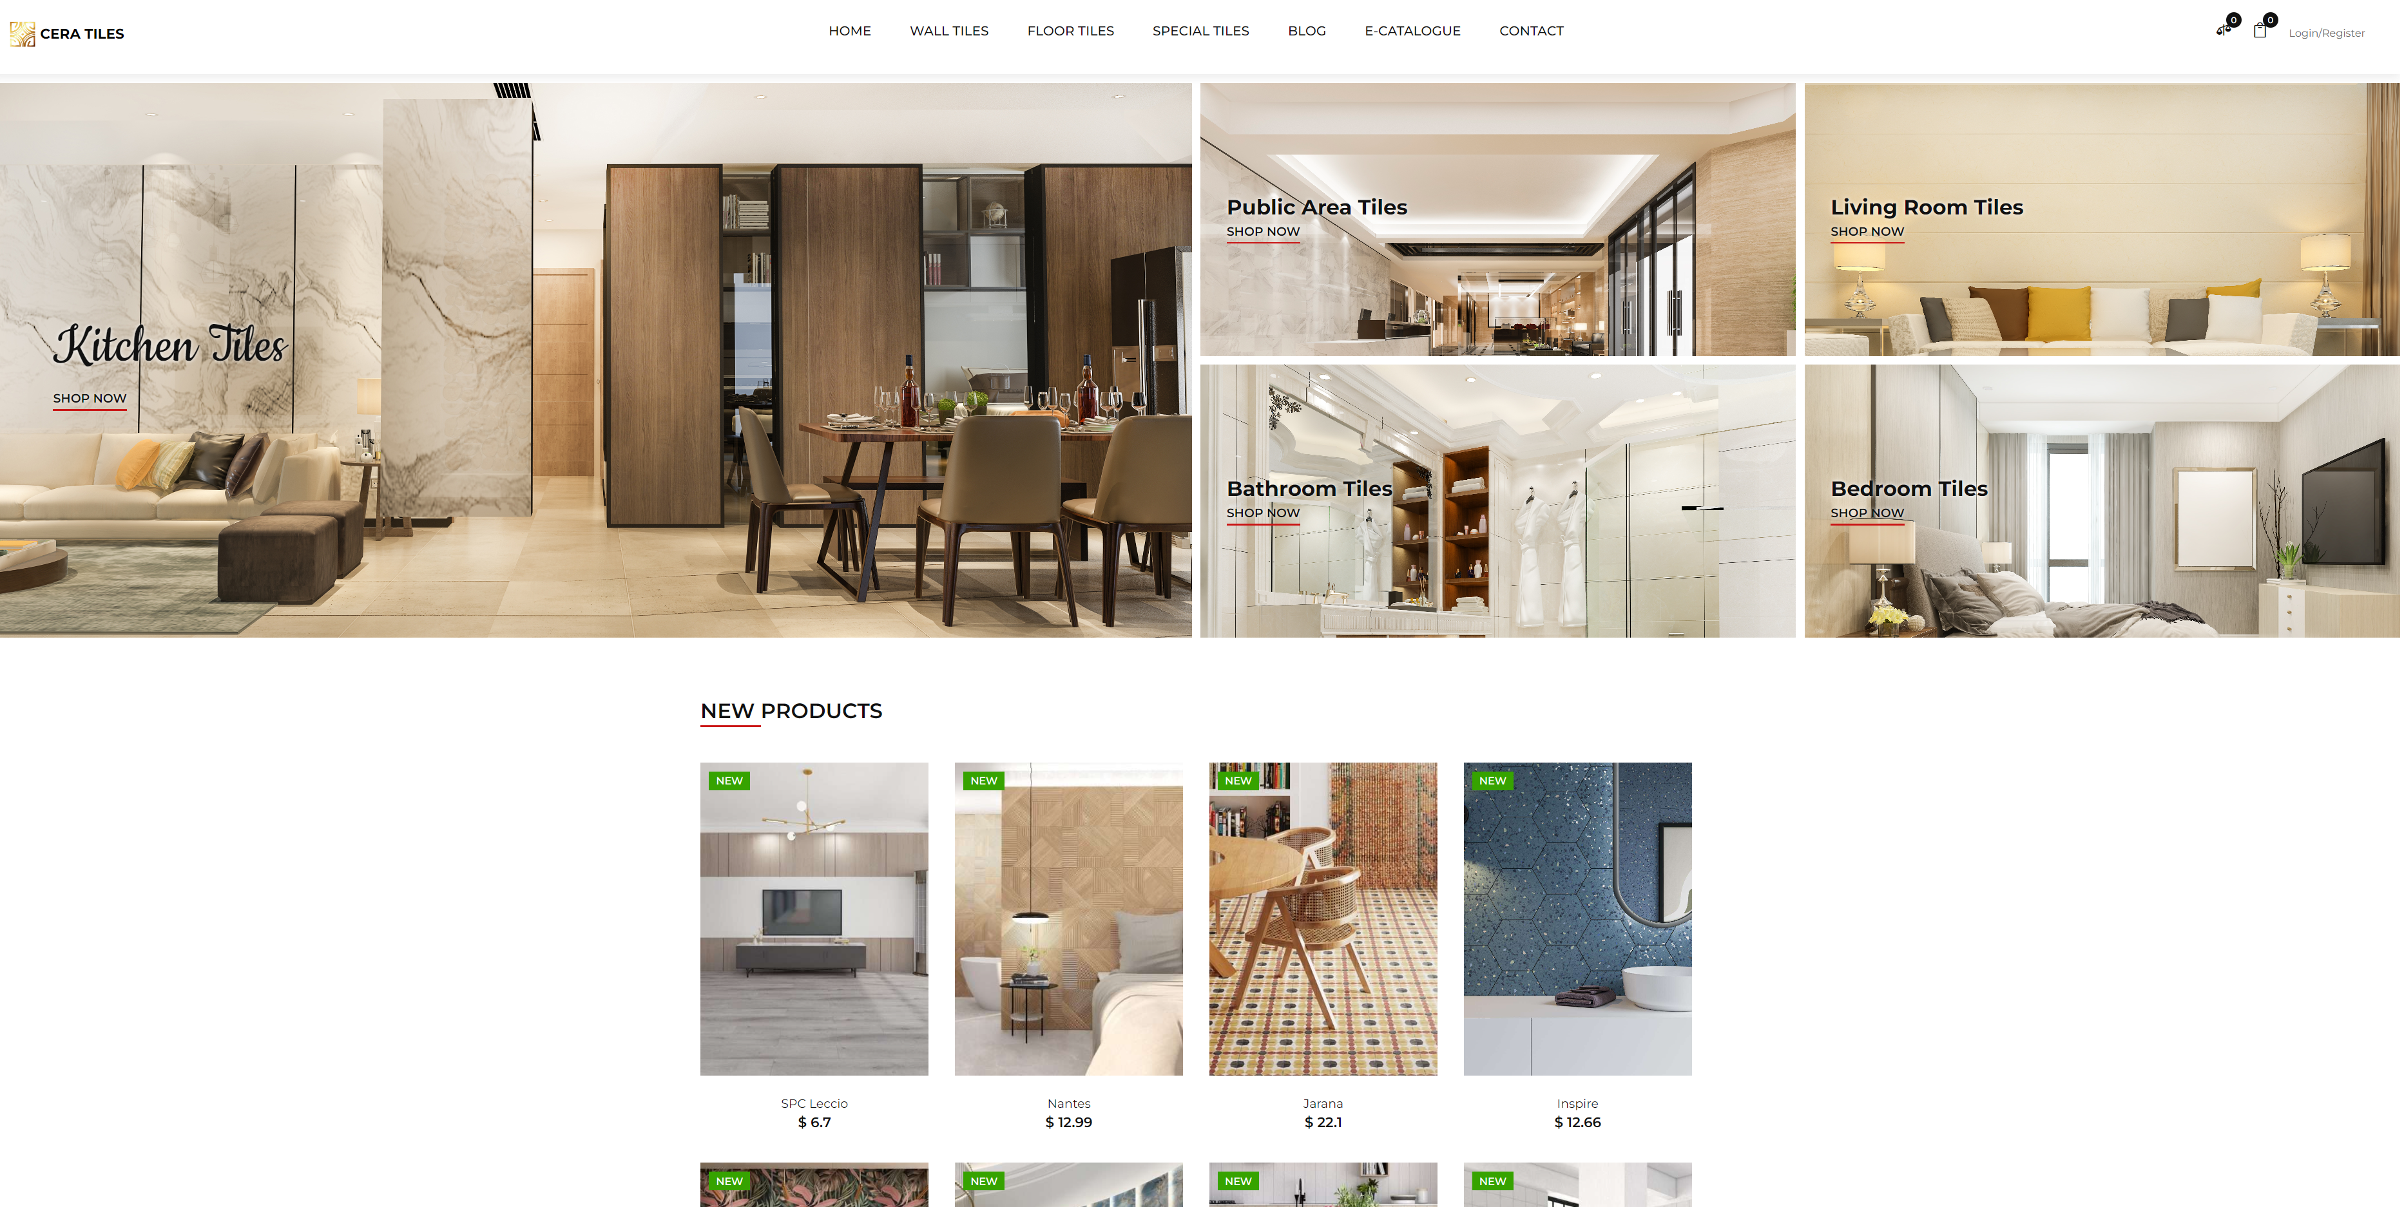
Home page

Slide 50
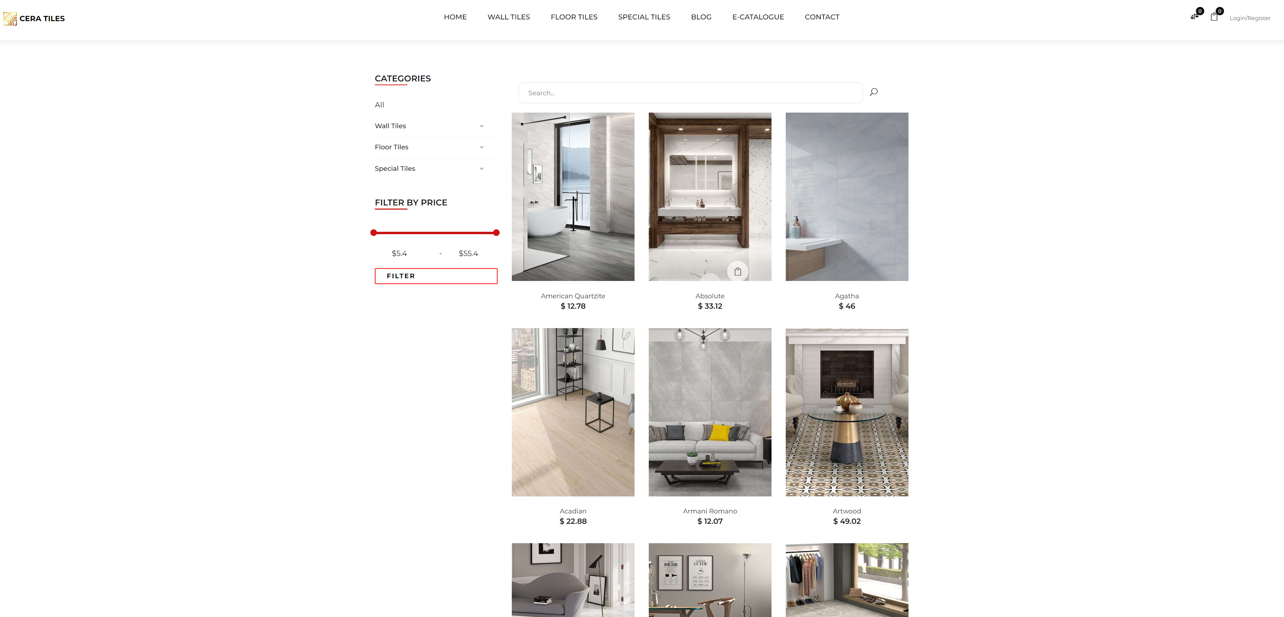
Product list

Slide 51
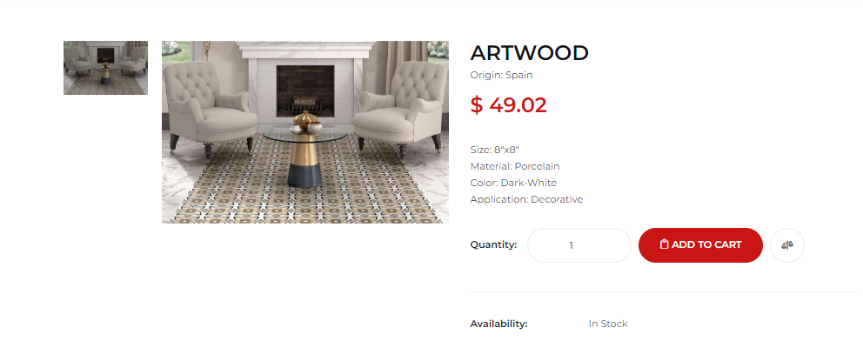
Product Details

Slide 52
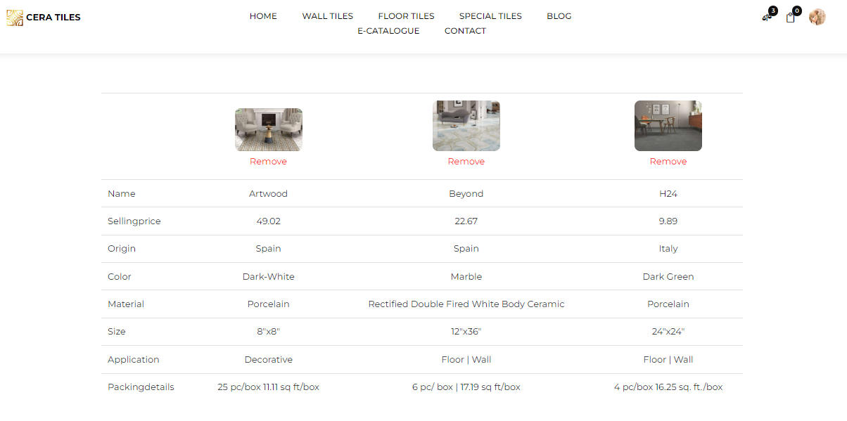
Product comparison

Slide 53
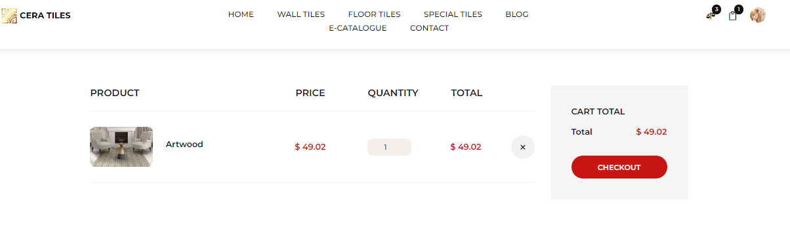
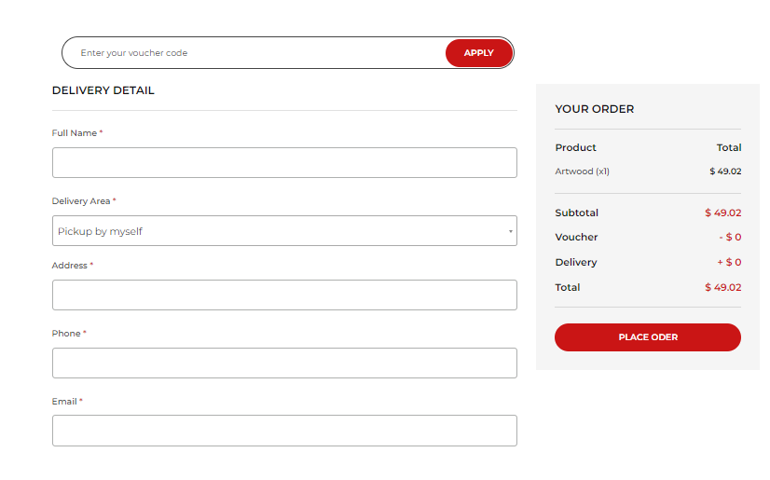
Click the bag icon to access shopping cart
Enter voucher code and apply here
After filling in all information, click here to proceed with payment.
Checkout page

Slide 54
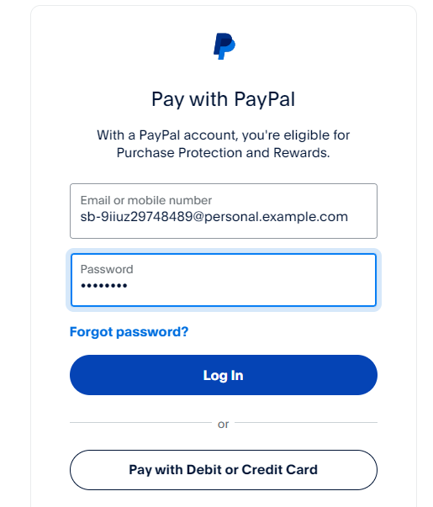
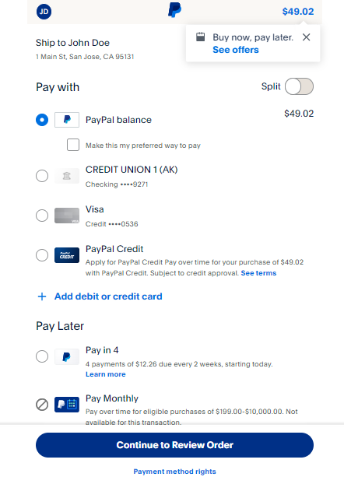
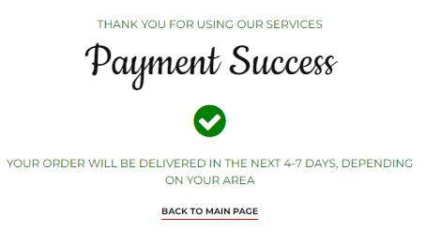
Select the method you want to pay.
Log in to your Paypal account
Payment success.

Slide 55
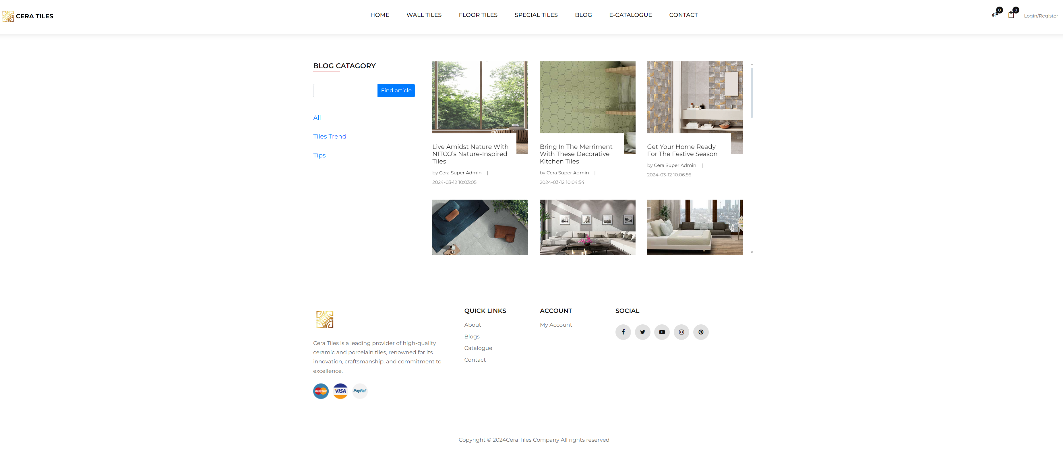
Blog section

Slide 56
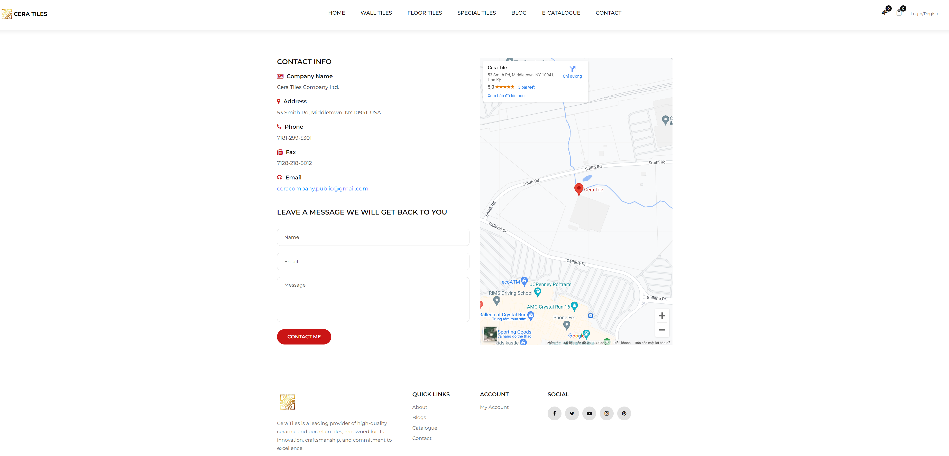
Contact page

Slide 57
THANK YOU
FOR YOUR LISTENING

